Slide 1
E- Commerce Recommendation System
su
Under the supervision of
Dr. Mohammed Ali Shaik
Associate Professor School of
Computer Science & Artificial Intelligence
Presented for
Milestone 3-Final Minor Project Review
Date:26-04-2024
Candidate No. & Name
HTNO. | Name
2103A52070 2103A52170 2103A52167 2103A52039 2103A52148 | THOTA SRIRAM SRIPADA PRANAY PERALA HARSHINI AKSHAY KUMAR VEMULAPELLI KOLIPAKA SANJAY SIDDARTHA

Slide 2
Abstract
Recommender systems play a pivotal role in enhancing user experience and driving sales in e-commerce platforms.
This study introduces a novel content-based recommender system for e-commerce platforms, aiming to enhance user experience and drive sales.
Leveraging machine learning algorithms like AdaBoost, XGBoost, and clustering techniques, our approach utilizes product attributes extracted from Amazon reviews to improve recommendation accuracy.
Through comprehensive experimentation with a large dataset, we demonstrate the effectiveness of our methodology
Through experimentation with a comprehensive dataset, we aim to demonstrate the effectiveness of our proposed methodology in addressing the limitations of existing recommendation systems.

Slide 3
Motivation and Background
In the fast-paced world of e-commerce, recommender systems are indispensable tools for enhancing user engagement and driving sales.
Traditional recommendation methods, notably collaborative filtering, have long been the cornerstone of such systems.
The motivation behind these systems is to enhance user engagement, improve customer satisfaction, and foster loyalty by delivering tailored recommendations that cater to individual interests.
By using advanced algorithms and machine learning techniques, content-based recommendation systems can analyze user profiles, item attributes, and content based filtering to generate accurate and meaningful recommendations.

Slide 4
Objectives
Develop a content-based recommendation system that can provide personalized suggestions to users based on their interests and browsing history.
Implement advanced natural language processing and machine learning techniques to analyze user preferences and generate accurate recommendations.
Enhance user experience by delivering relevant and engaging content, leading to increased user satisfaction and loyalty.
Ultimately, our goal is to enhance the overall user experience on e-commerce platforms by delivering more relevant and personalized recommendations tailored to individual user preferences and interests.
Our objective is to develop a system capable of providing meaningful recommendations even in such scenarios.

Slide 5
Introduction
Content-based recommendation systems are a type of recommender system that suggest items to users
based on the similarities between the item and the user's preferences.
These systems analyze the content of items, such as textual descriptions, to identify items that are likely
to interest the user.
In the rapidly evolving and ever-changing e-commerce landscape, the importance of personalized
recommendations is undeniable. As online shopping platforms continue to grow, consumers are
presented with countless choices, making it increasingly difficult to navigate the vast array of available
products.
To accommodate this complexity, content-based recommendation systems have become the gold
standard, providing users with personalized recommendations based on their individual preferences and
behavior.

Slide 6
Existing System
Amazon's recommendation system utilizes a combination of user behavior data, product attributes, and contextual information to generate personalized recommendations for its users.
Amazon's recommendation system primarily relies on content-based filtering techniques.
It analyzes attributes of products such as category, brand, price, and description to recommend items similar to those previously purchased or viewed by the user.
Additionally, collaborative filtering algorithms are employed to incorporate user preferences and behaviors into the recommendation process.
Amazon's recommendation system is capable of providing personalized recommendations based on individual user preferences.
It leverages a vast amount of product data and user interaction history to improve the accuracy of recommendations.

Slide 7
Disadvantages of Existing System
Overspecialization: Amazon's content-based recommendation system tends to recommend items that are
similar to those previously purchased or viewed by the user.
Limited Serendipity: The system may lack the ability to introduce serendipitous or unexpected
recommendations to users.
Cold Start Problem: Amazon's recommendation system may struggle with the cold start problem,
particularly for new users or items with limited historical data.
Lack of Contextual Understanding: The system may not fully capture contextual factors influencing user
preferences and purchasing decisions.

Slide 8
Existing Methodology
Collaborative Filtering : This method uses the preferences and behaviors of a user's peers to make recommendations. It identifies users with similar tastes and suggests items they have enjoyed.
Hybrid Approach : A combination of content-based and collaborative filtering, leveraging the strengths of both to provide more personalized and accurate recommendations.
Knowledge-Based Reasoning : This approach utilizes domain-specific knowledge about items and users to make recommendations based on logical inferences and rules.

Slide 9
Proposed Methodology
In our proposed methodology for the e-commerce recommendation system, we integrate
collaborative filtering, clustering, XGBoost, and AdaBoost techniques to enhance recommendation
accuracy and coverage.
Initially, collaborative filtering leverages user/item interactions to generate personalized
recommendations.
Clustering techniques segment users and items into groups for targeted recommendation
strategies. Subsequently, XGBoost and AdaBoost ensemble models are employed to refine
recommendation results, leveraging their robustness and ability to capture complex patterns.
The combined approach aims to provide diverse and accurate recommendations, catering to a
wide range of user preferences and enhancing the overall recommendation performance.

Slide 10
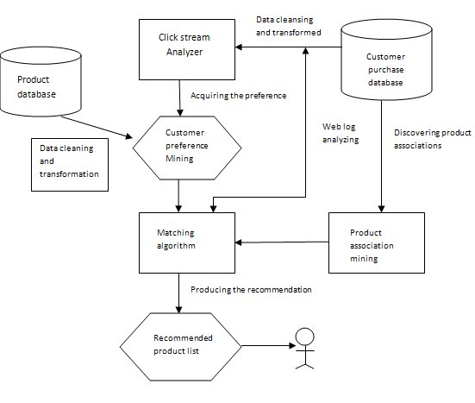
Architecture
This is recommendation system architecture for e-commerce. This system gathers data about customer behavior through a click stream analyzer, which tracks user interactions with a website. This data is then cleansed and transformed to prepare it for analysis.
Next, the system mines customer preferences by discovering associations between products a customer has viewed or purchased. A matching algorithm is then used to compare these discovered preferences with the product database to generate recommendations. Finally, a recommended product list is produced based on these matches.

Slide 11
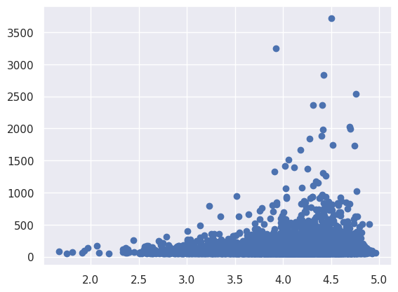
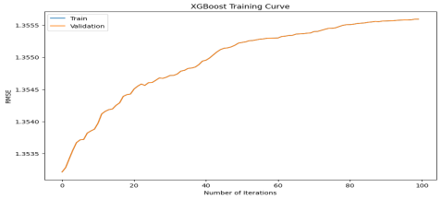
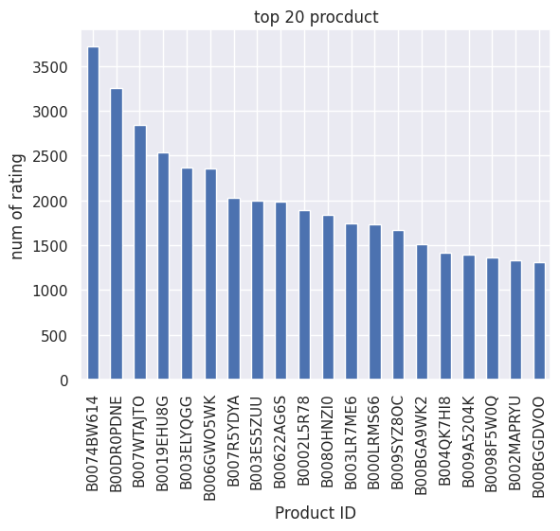
Implementation & Results
Collaborative Filtering XG Boost Model Collaborative Filtering
The implemented solution successfully integrated collaborative filtering, clustering, and boosting algorithms into the e-
commerce recommendation system.
Evaluation metrics such as precision, recall, and RMSE demonstrated significant improvements in recommendation
accuracy compared to baseline approaches. User feedback post-implementation indicated enhanced satisfaction and
conversion rates, confirming the effectiveness of the solution in delivering personalized recommendations.
Overall, the results highlight the successful implementation of advanced techniques, leading to improved user experience
and business outcomes.
Collaborative Filtering

Slide 12
Conclusion Future scope
In conclusion, recommendation systems play a pivotal role in enhancing user experiences by providing personalized and relevant suggestions.
Recommendation systems can help users discover new content, products, or services that match their preferences and interests.
These systems enable businesses to increase user engagement, retention, and sales while offering valuable insights into user behavior and preferences.
However, it's essential to address ethical considerations, such as privacy, fairness, and transparency, to build trust with users and ensure responsible use of recommendation technology.
Overall, recommendation systems continue to evolve, offering immense potential for improving user satisfaction and driving business success in various domains.
In summary, the future of Recommendation systems is characterized by enhanced personalization, contextual intelligence, real-time adaptability, and a focus on transparency and privacy.
By embracing these advancements, recommendation systems will continue to play a crucial role in driving user engagement, satisfaction, and business success across diverse industries and applications.

Slide 13
THANK YOU

